Slide 1
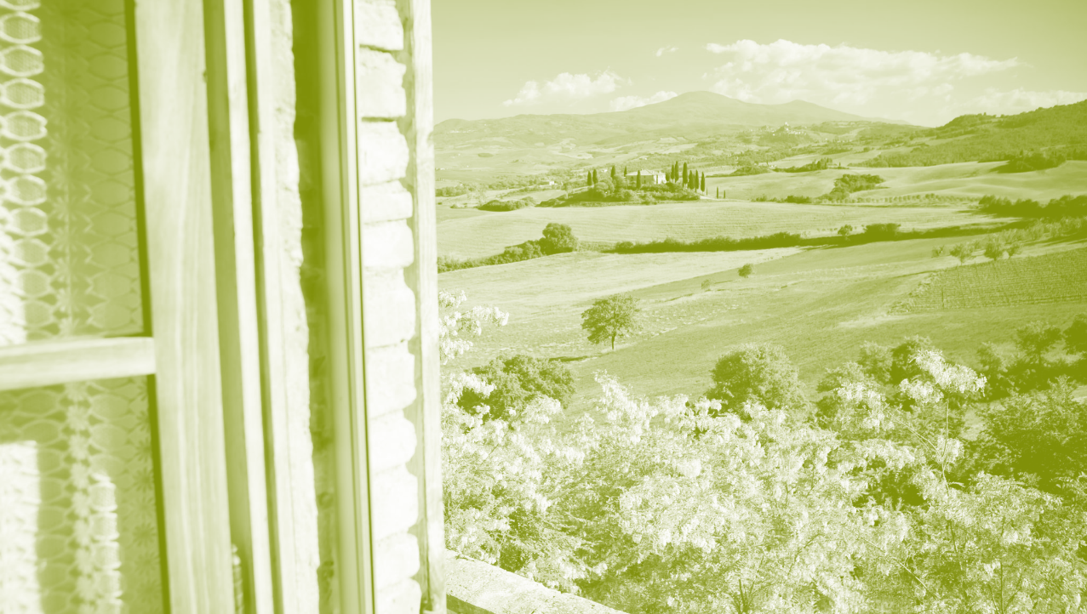
OUR COUNTRY

Slide 2
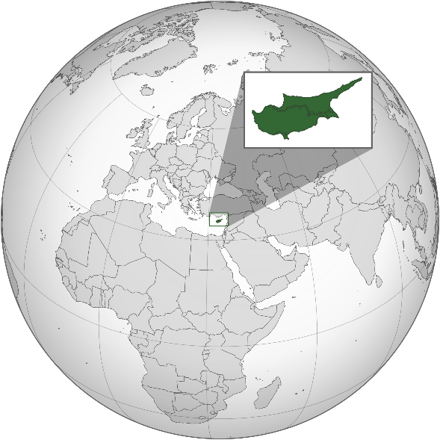
CYPRUS
A unique island
in the Mediterranean sea

Slide 3
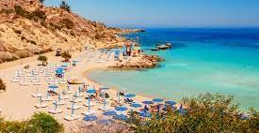
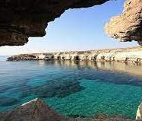
CYPRUS … A UNIQUE, BEAUTIFUL ISLAND FAMOUS FOR ITS SUNNY BEACHES…

Slide 4
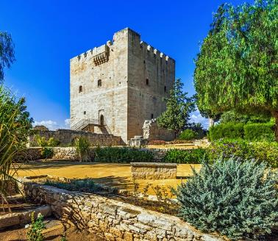
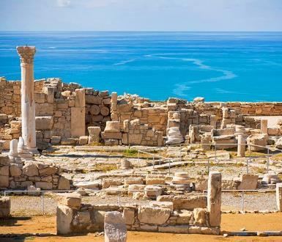
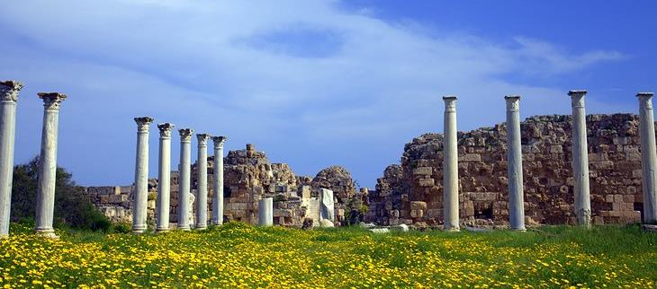
HISTORY AND CULTURE

Slide 5
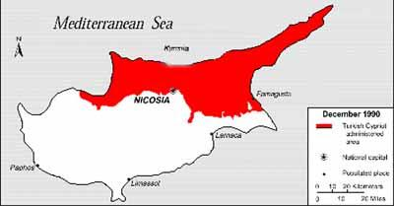
Turkish invasion 1974…2024

Slide 6
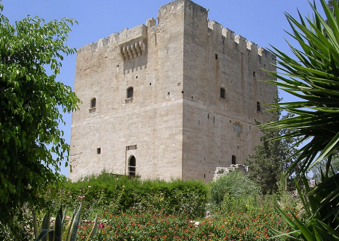
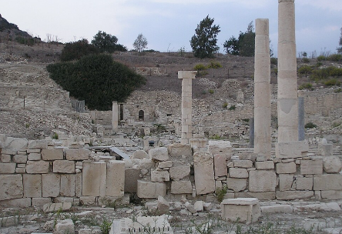
Limassol
Our school is situated in Pyrgos village, in Limassol district.
Limassol is the second largest urban area in Cyprus, after Nicosia, the capital city of the island. Limassol is a cosmopolitan city, as it attracts many foreign people, who come either for holiday, or for work.
The city of Limassol is situated between the ancient cities of Amathus and Kourion or Curium and was probably built after Amathus had been ruined. However, the area of Limassol has been inhabited since very ancient times. Graves found there date back to 2000 BC.

Slide 7
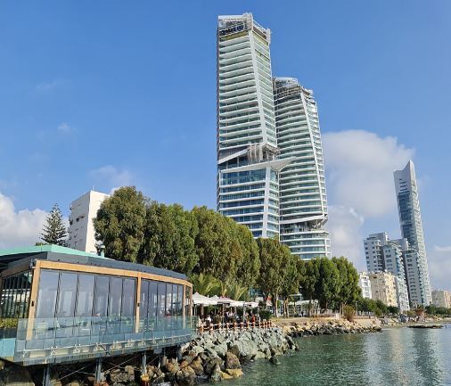
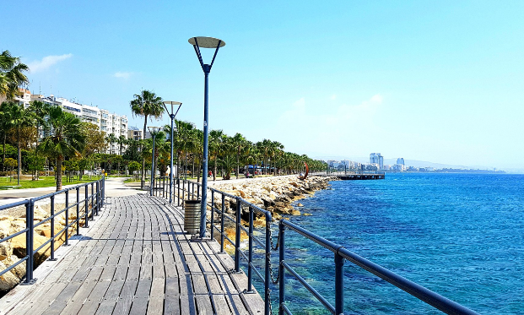
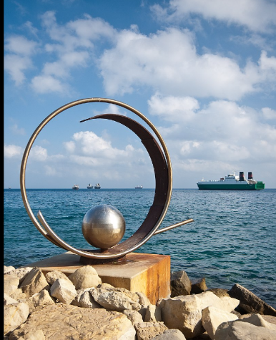
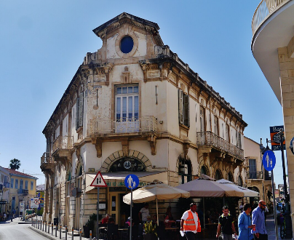

Slide 8

OUR VILLAGE

Slide 9
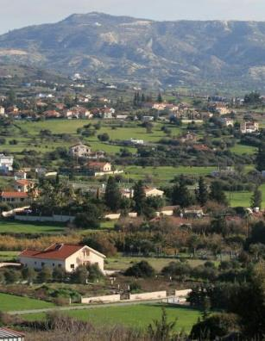
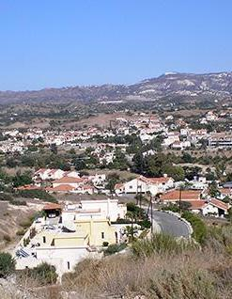
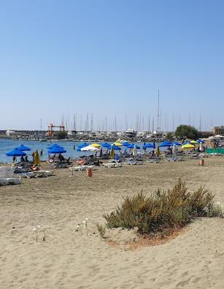
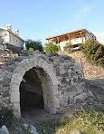
PYRGOS VILLAGE, LIMASSOL DISTRICT

Slide 10
The village of Pyrgos
Pyrgos is located approximately 15km east of the city of Limassol, in a valley crossed by small streams.
One of them was utilized by a metallurgical workshop, for the processing of copper, as early as the second half of the third millennium BC. and which is presented as the most ancient testimony of the kind so far known in the world.

Slide 11
Pyrgos, known as “Aroma village”
A team of Italian archaeologists excavating in Cyprus believe they have discovered the oldest perfumery in the world. It is located in the area of ​​the village of Pyrgos in Limassol in the location of Mavrorahi. Chronologically, the factory facilities belong between the early and middle Bronze Age, specifically around 2000 BC. about. Two complete stills have been found among 90 clay objects. Their discovery predates the distillation technique by 2600 years. According to the excavators, the 4000-year-old perfumery had its sought-after products throughout the Eastern Mediterranean.
https://www.cyprusalive.com/en/village/limassol-pyrgos
https://www.pyrgos.org/en/history-len.html
https://knews.kathimerini.com.cy/en/news/pyrgos-dig-reveals-industrial-plant-dating-back-to-2350-bc

Slide 12
ERASMUS KA122
Erasmus project will link our village’s long history and culture to the culture of the students’ consisting our school, so as to realize the importance of peaceful coexistence, the value of respect to promote quality of life…

Slide 13
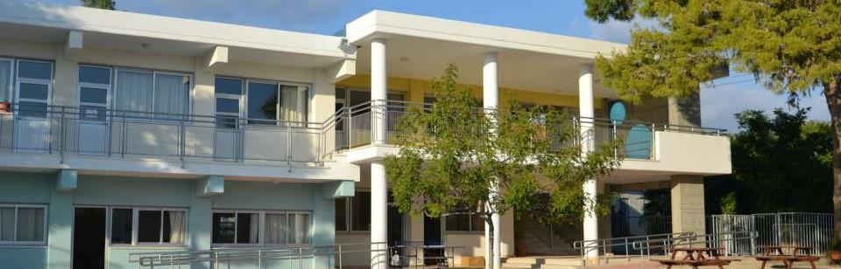
OUR SCHOOL
Pyrgos Primary School

Slide 14
Our school… The way we work… our vision
Our vision is to create a school in which all students feel valued, appreciated and safe.

Slide 15
Our activities…

Slide 16
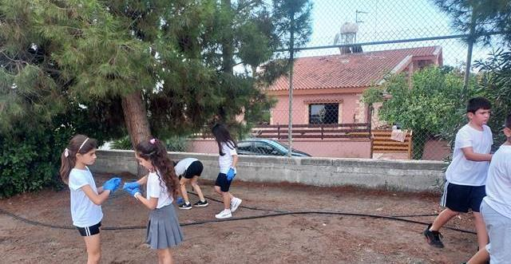
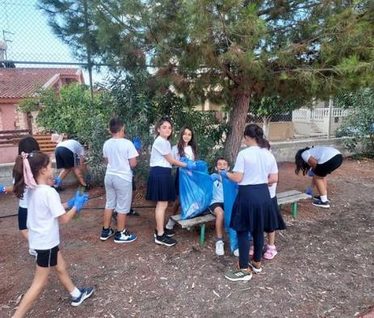
ENVIRONMENTAL EDUCATION

Slide 17
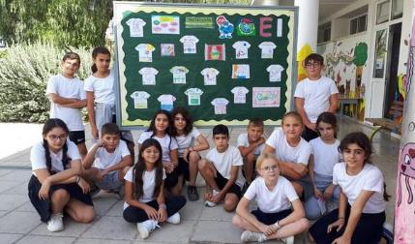

Environmental education
We implement cleaning of our school, our nearby beach, marked with a blue flag.
We plant trees and herbs.
We visit environmental institutes.

Slide 18

USING INFORMATION TECHNOLOGY

Slide 19
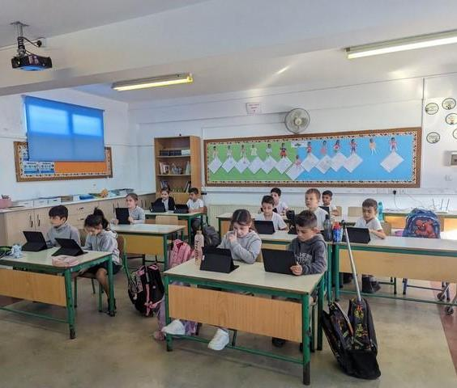
We create teachers’ workshops, exchange ideas and implement lesson plans, with the help of our Pedagogical Institute. We reflect upon teaching, ameliorate lesson plans and implement again.

Slide 20
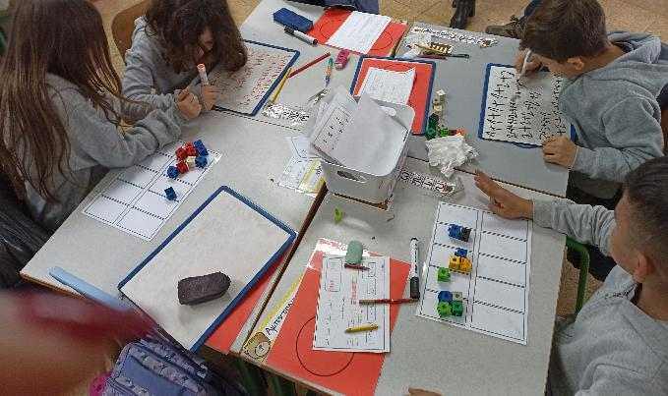
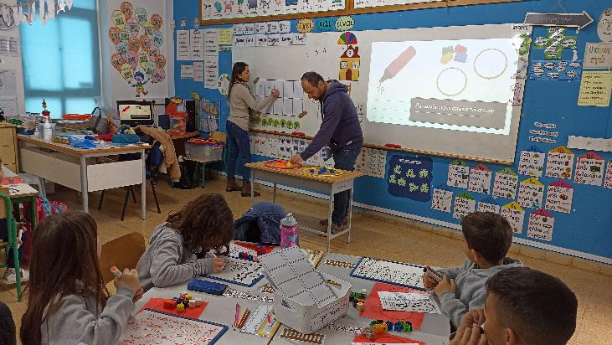
Differentiated instruction

Slide 21
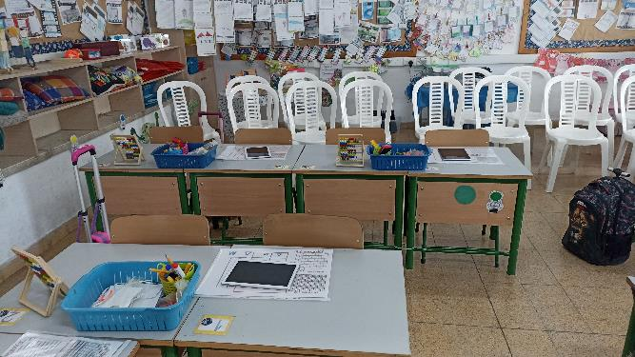
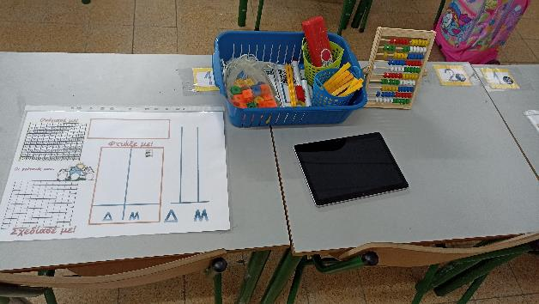
Our school is open to parents. We invite them watch and participate in lessons.

Slide 22
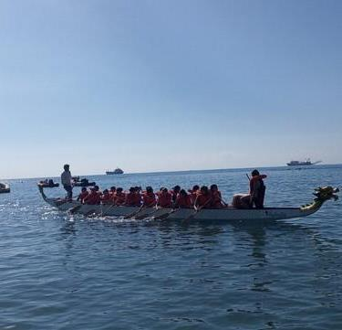
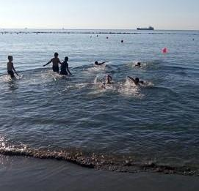
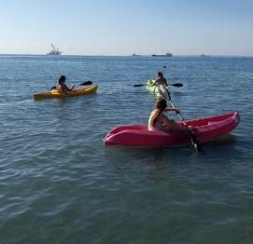
OUTDOOR ACTIVITIES…

Slide 23
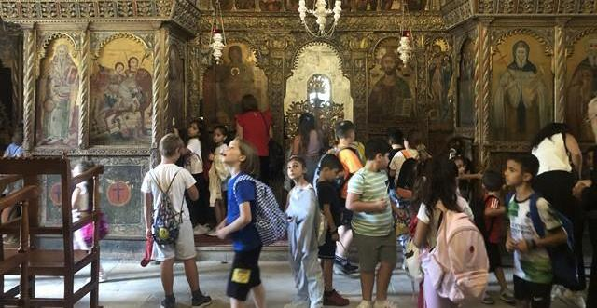
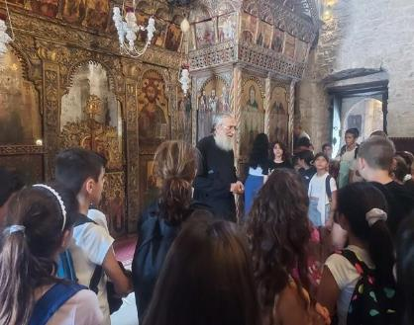
WE VISIT MUSEUMS AND CULTURAL HERITAGE MONUMENTS, PROTECTED BY UNESCO. PANAGIA AGGELOKTISTI, LARNACA DISTRICT…

Slide 24
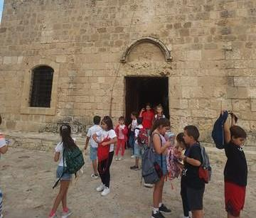
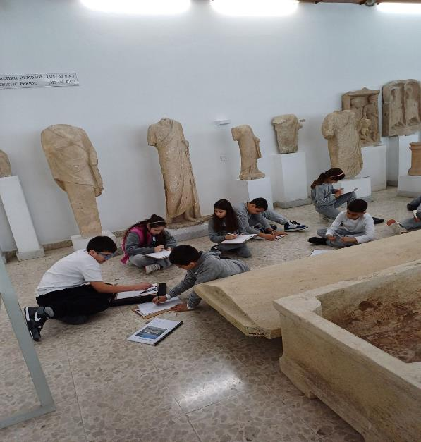

Slide 25
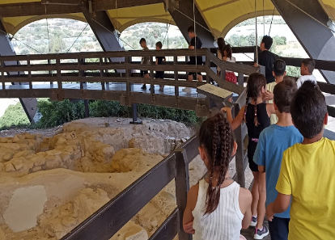
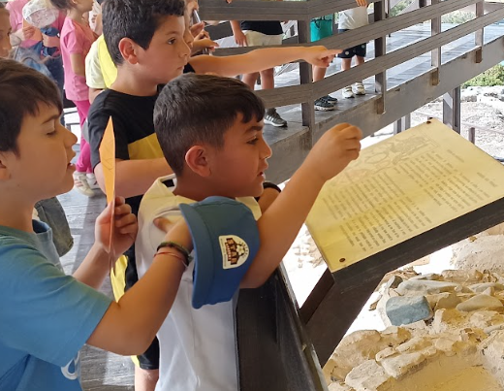
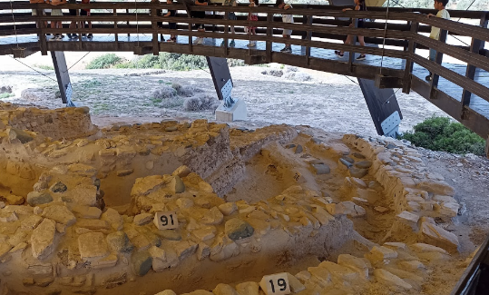
Archeological site of Kalavasos-Tenta

Slide 26
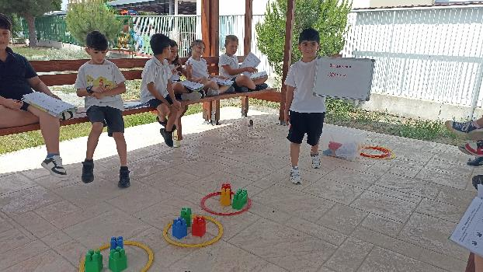
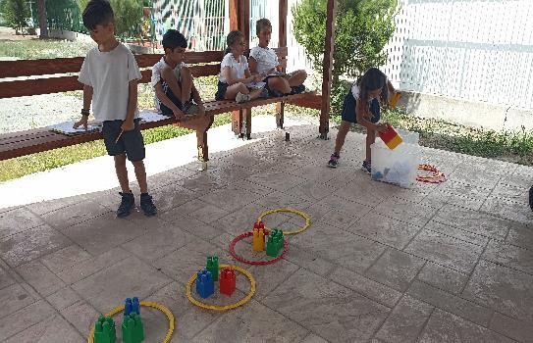
We love teaching outside the classroom…

Slide 27
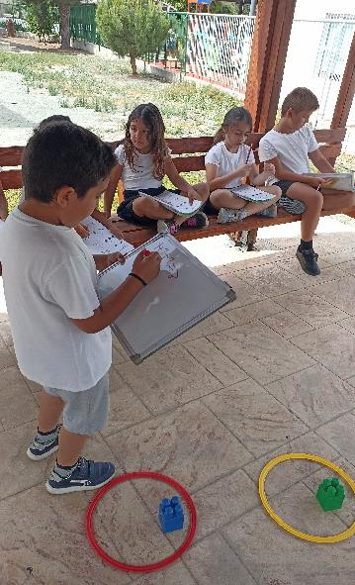
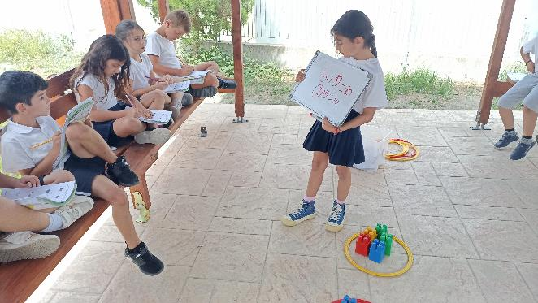
We also learn how to teach each other.

Slide 28
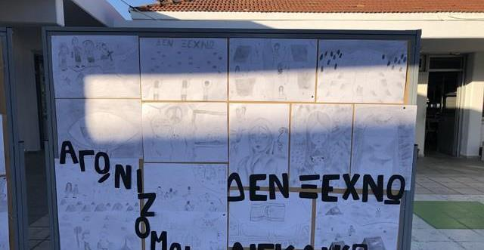
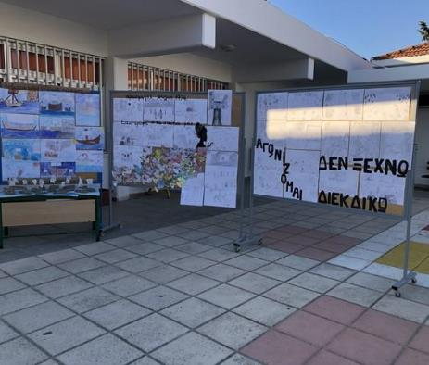
History through art and drama

Slide 29
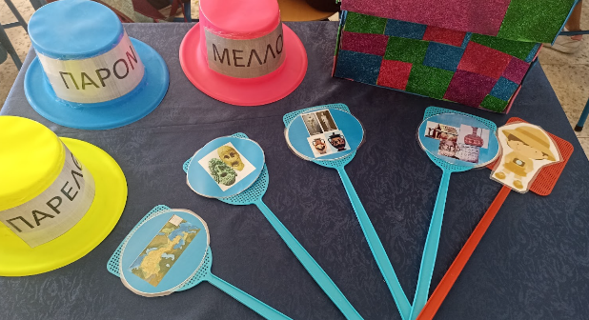
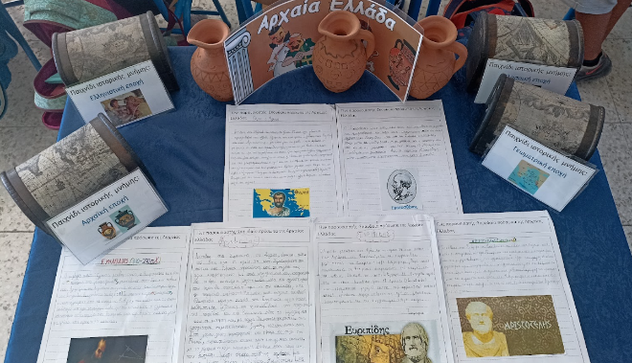
We learn about our history and culture using drama techniques and art.

Slide 30
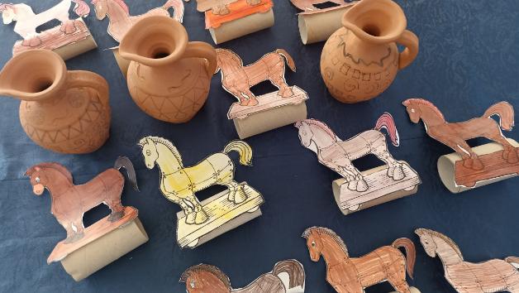
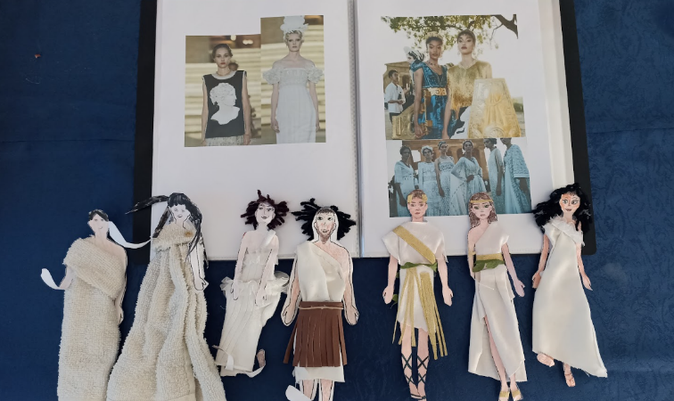
We make crafts and we even design ancient Greek costumes!

Slide 31
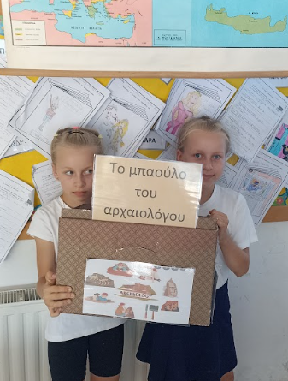
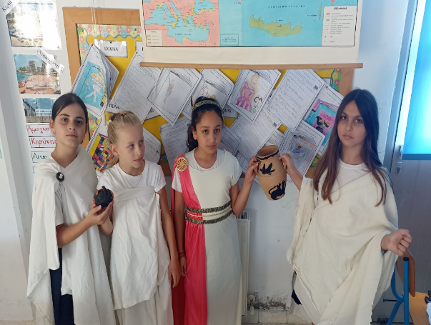
We wear ancient Greek costumes and we play roles, so as to have a better understanding. We become archeologists to maintain clearer picture of our roots…

Slide 32
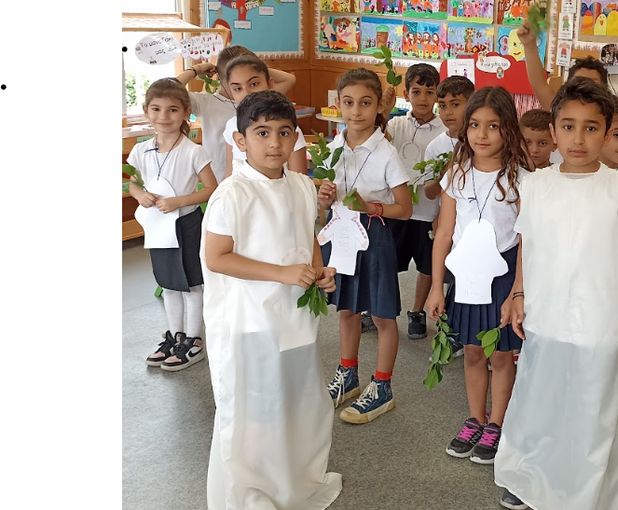

We present Easter customs with a dramatization.

Slide 33



Shadow theatre

Slide 34


Everyone is unique! We are all special!

Slide 35


Genes day Our rare Leon!

Slide 36



COMMUNICATING OUR SUPPORT TO PATIENTS WHO SUFFER FROM CANCER, THROUGH ARTS…

Slide 37

We cultivate the love in reading books, while promoting life skills of inclusion, cultivating diversity, respect. We use drama activities and art.
“The triangular fish in the strange fish’s world”, Vaggelis Iliopoulos
“The triangular fish against the big shark”, Vaggelis Iliopoulos

Slide 38


“Elmer”, David Mc Kee

Slide 39

“Seven, the octapus”, Loukas Panayi

Slide 40

Role play activities

Slide 41



A drama workshop created by primary school teachers, in cooperation with Pyrgos Kindergarden.

Slide 42



Slide 43

Arts and crafts

Slide 44


The same drama workshop was presented to “Iamatiki Primary school”, during summer school, July 2024, by teachers of our school.

Slide 45



A multicultural school CLIL in Year 1 Maths teaching

Slide 46




Our Christmas play: “The story of the old shoemaker”

Slide 47
ERASMUS KA122 MOBILITIES … A LIFETIME OPPORTUNITY TO ENHANCE OUR KNOWLEDGE AND QUALIFICATIONS, AS OUR TEACHERS ARE A COMMUNITY OF LIFE LONG LEARNERS…

Slide 48
Project title: Teaching in a diverse school envirornment Cultivating harmonious relationships among all students, through arts and drama, taking advantage of the opportunities of ICT and learning indoors and outdoors.

